Slide 1
Stat 495r – Presenting Data
Week 14 – R Shiny

Slide 2
Announcements
Data Science Club follow-up
Next week is the final week – Maps and Interactivity
Grades should all be up to date
Feedback?

Slide 3
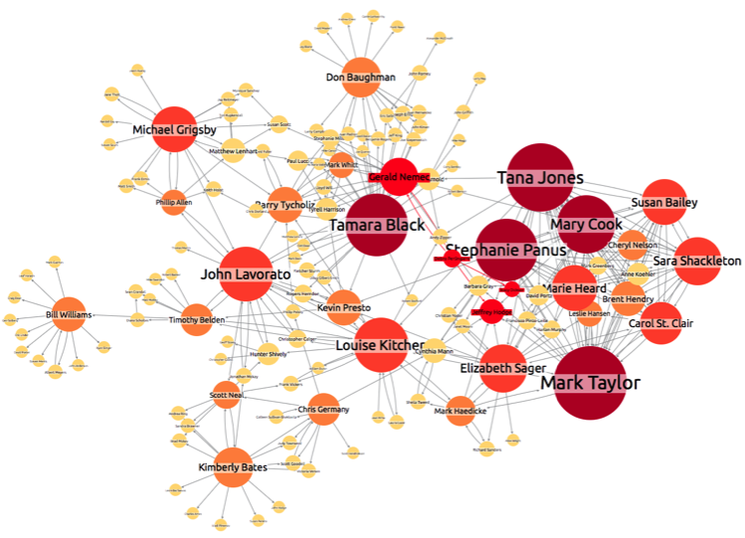
Data Viz #1
Notes:
Network Graph
The Enron email corpus is publicly available – it was used to make Siri and also Google Autocomplete
But it is comprised of 150 people from Dallas TX, some who did clearly illegal (and immoral things)
Network analysis and visualization has helped identify bad actors and improper behavior

Slide 4
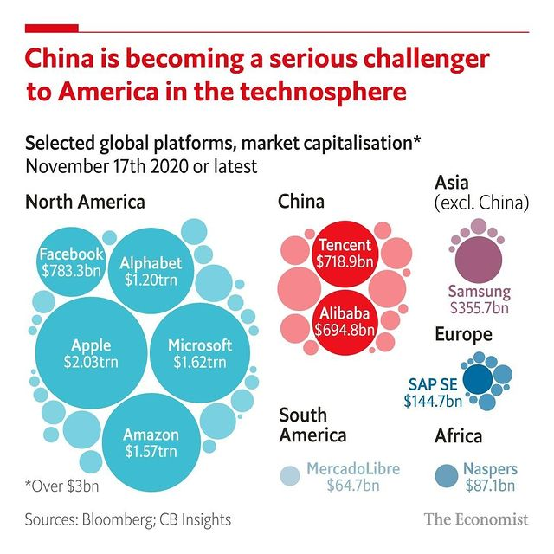
Data Viz #2
Notes:
Good example of bubble chart

Slide 5
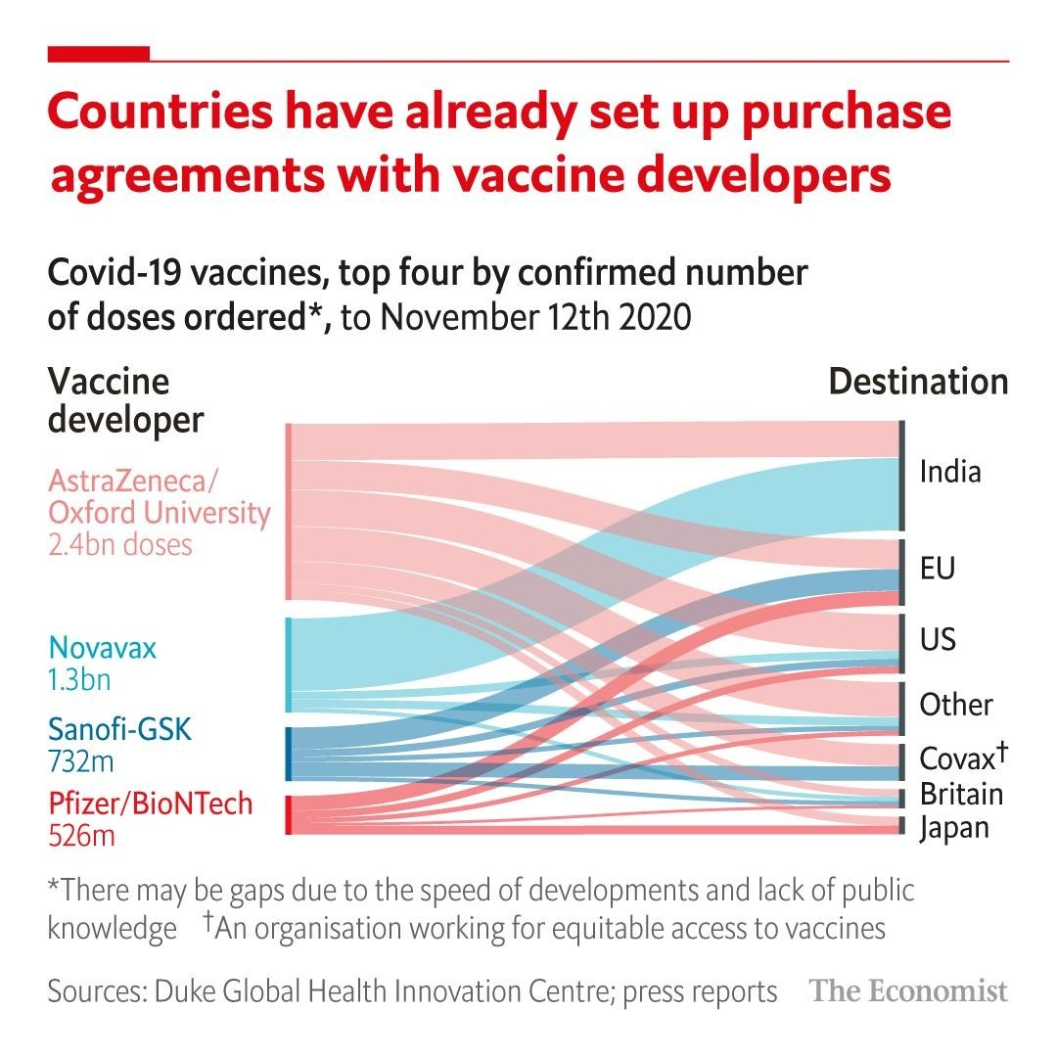
Data Viz #3
Notes:
Sankey Chart- good for showing flows

Slide 6
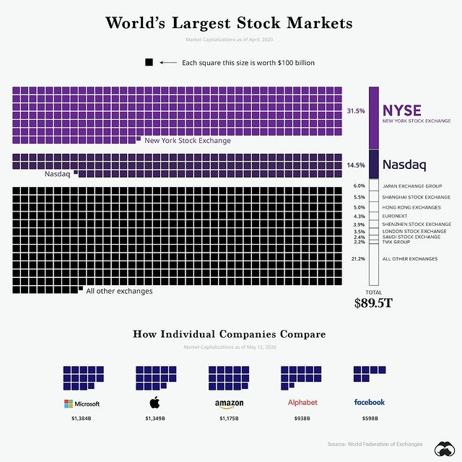
Data Viz #4
Notes:
Sankey Chart- good for showing flows

Slide 7

R Shiny

Slide 8
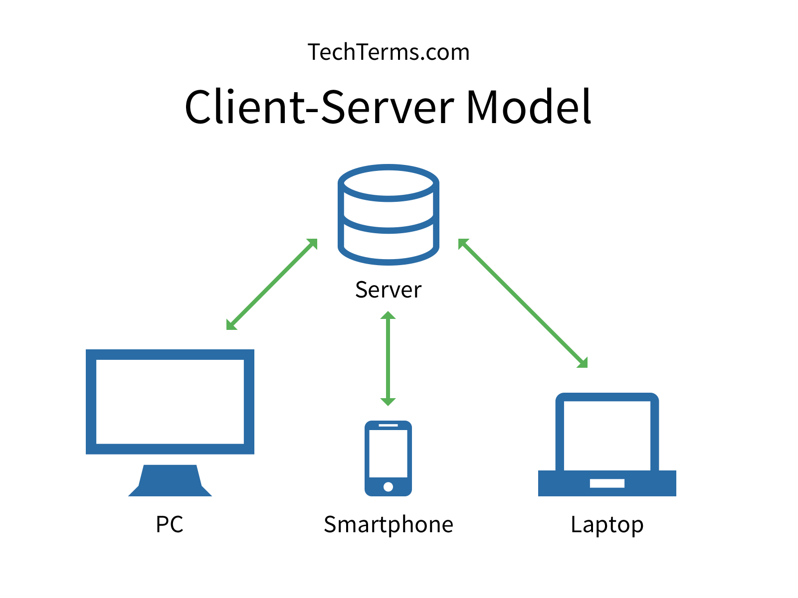
What is R Shiny?
Shiny is an easy way to make web pages. These web pages have the advantage of being fully programmable in R (Shiny converts your R code to HTML, JavaScript, CSS, etc). They provide a client-server relationship where the client is served information that is processed on a Server running R.
R code runs here (on Connect)
HTML displays here (in person’s browser)

Slide 9
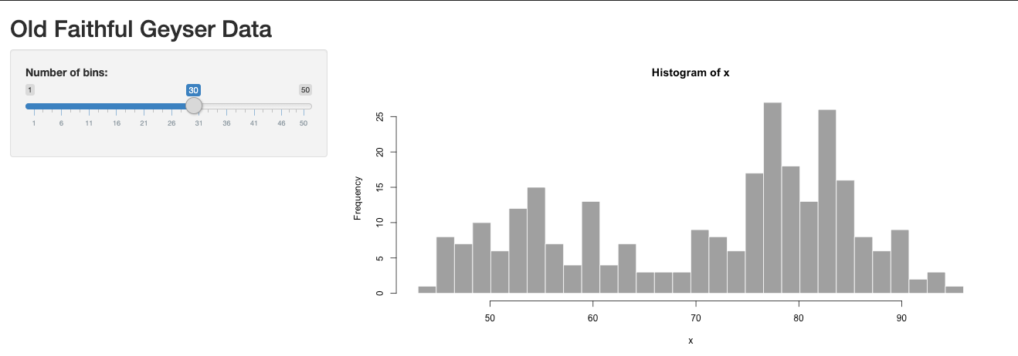
Examples
Shiny is a package pre-installed by R Studio (like the tidyverse packages and others)
Note: when you create a new Shiny app from R Studio a new directory (e.g., folder) is created to house the file and associated files
https://shiny.rstudio.com/gallery/
Steal code from these examples!!!
Notes:
Start from this template in Rstudio
The ”Run App” is code for runApp("my_app") and can be toggles
runExample("01_hello") # a histogram
runExample("02_text") # tables and data frames
runExample("03_reactivity") # a reactive expression
runExample("04_mpg") # global variables
runExample("05_sliders") # slider bars
runExample("06_tabsets") # tabbed panels
runExample("07_widgets") # help text and submit buttons
runExample("08_html") # Shiny app built from HTML
runExample("09_upload") # file upload wizard
runExample("10_download") # file download wizard
runExample("11_timer") # an automated timer

Slide 10
The Shiny Structure: 3 Parts
The UI function defines how the app looks. In the UI function, you call a bunch of R functions that defines how the page is laid out. These functions simply generate HTML and JavaScript that is used in the client’s browser.
The server function defines what the app does. In the UI you put a placeholder for a graph. In the server, you run the R code that produces the graph. Shiny takes care of all the communication between the client’s browser and your server.
UI
Server
shinyApp() Function Call
Compiles to HTML
Runs in client’s browser
Most elements are static
Acts as placeholders for dynamic elements
Runs R code
Runs on Connect (or wherever it’s hosted)
Provides the logic to create dynamic content
Shiny sends the results of the R code to the UI to display
Notes:
Stylistically Shiny prefers camelCase veruse tidyverse’s under_score

Slide 11
File Names Matter in R Shiny
One File
Two Files
ui.R
app.R
library(shiny)
shinyUI <- ...
library(shiny)
ui <- ...
server <- ...
shinyApp(ui = ui, server = server)
server.R
library(shiny)
shinyServer <- ...
Notes:
Why are each useful? When would you want to use each setup?

Slide 12
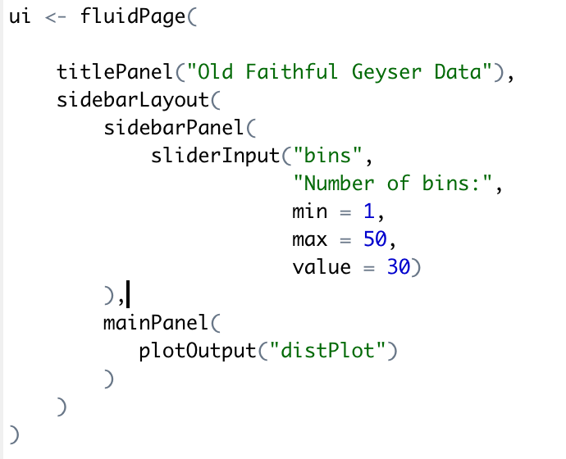
A Simple UI
UI components fall into three main groups:
Static elements – these just define how the page looks, they don’t interact with the server. Can be thought of like HTML.
Inputs – These provide controls for the client to provide information to Shiny. These include buttons, sliders, drop-downs, text boxes, and a whole lot more.
Outputs – These act as placeholders that will display things that are calculated by the server. These include graphs, tables, text, and more.
Both inputs and outputs have “ID” as their first argument, which allows you to give them a name.
Notes:
A

Slide 13
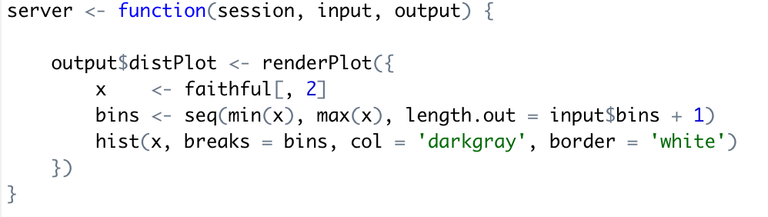
A Simple Server
In the server, you tell what code to use to generate the outputs. You assign outputs to the output variable (see example above). This function will run anytime the client changes the slider (input$bins). This behavior is known as reactivity.

Slide 14
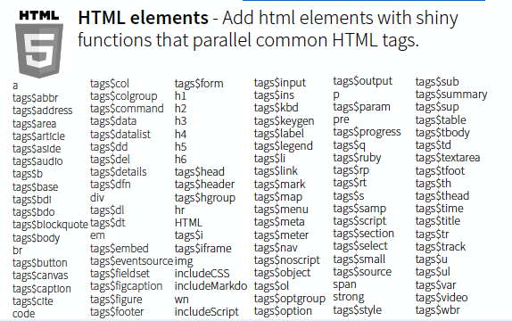
Layouts – how your dashboard looks
fluidPage() Creates a display that adjusts to the width of your browser (alternatives include bootstrapPage and navbarPage )
sidebarLayout() Creates a layout for your page (alternates include splitlayout, flowLayout, fluidRow )
Headers
paragraph
hyperlink
Line break (equivalent of “return” on the keyboard) to add some vertical spacing
italicize
Horizontal line
Bold
Notes:
Here you need to know a little bit about HTML

Slide 15
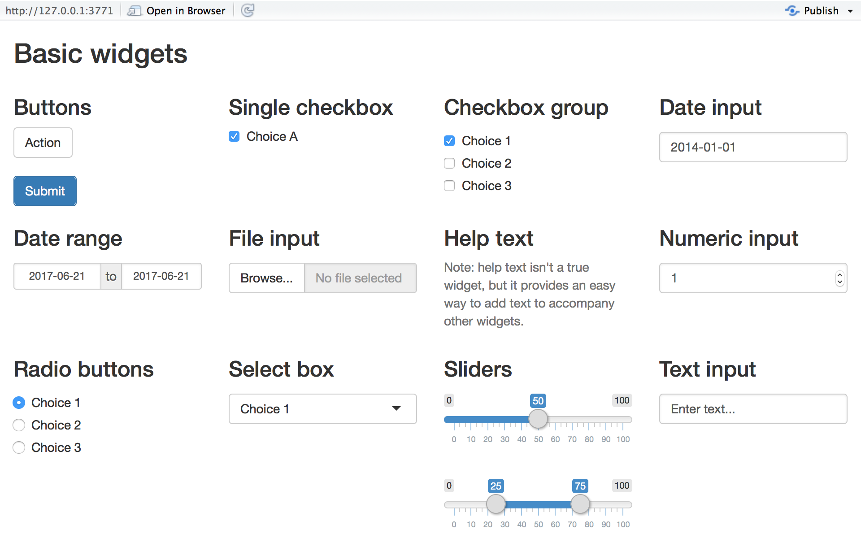
Control Widgets – what makes your dashboard interactive
Widgets need:
A name
A label
function | widget
actionButton | Action Button
checkboxGroupInput | A group of check boxes
checkboxInput | A single check box
dateInput | A calendar to aid date selection
dateRangeInput | A pair of calendars for selecting a date range
fileInput | A file upload control wizard
helpText | Help text that can be added to an input form
numericInput | A field to enter numbers
radioButtons | A set of radio buttons
selectInput | A box with choices to select from
sliderInput | A slider bar
submitButton | A submit button
textInput | A field to enter text
https://shiny.rstudio.com/gallery/widget-gallery.html
Notes:
Shiny provides a family of functions to create these widgets.
Each function requires a name and a label.
Some widgets need specific instructions to do their jobs.
You add widgets to your Shiny app just like you added other types of HTML content (see Lesson 2)

Slide 16
Outputs – your content
Your output must have a corresponding object in your server
Server functions can use your control widgets – this is called “reactivity”
Output UI function | Server function | Creates
dataTableOutput | renderDataTable | DataTable
htmlOutput | renderUI | raw HTML
imageOutput | renderImage | image
plotOutput | renderPlot | plot
tableOutput | renderTable | table
textOutput | renderText | text
uiOutput | renderUI | raw HTML
Notes:
use an *Output function in the ui to place reactive objects in your Shiny app,
use a render* function in the server to tell Shiny how to build your objects,
surround R expressions by curly braces, {}, in each render* function,
save your render* expressions in the output list, with one entry for each reactive object in your app, and
create reactivity by including an input value in a render* expression.

Slide 17
Publishing your Dashboard
shinyapps.io
Shiny Server (Free but you need servers like AWS)
R Connect (Paid to R Studio)

Slide 18
Homework

Slide 19
Homework 1
The date is March 2020
Use the data to create an R Shiny dashboard and host it on shinyapps.io
The dashboard should have two main visuals in a visually appealing format
The cumulative number of subscriptions made
The cumulative revenue received from subscriptions
Experiment with some of the following in your dashboard
The default timeframe should be the current month, but it would be nice to allow the timeframe have a toggle
Both monthly subscriptions and monthly revenue have a goal inputted by the user, use this to do either
From the current day, connect the current cumulative value to the total with a dotted line
Create a “pace” line that is straight from the 0 to the goal to see if the day if above or below the pace to get to the goal
A trend line or projection of what the month will look like if the pace continues
Send the URL to your hosted dashboard in an email
Next week, we will build upon this dashboard

